Slide 1
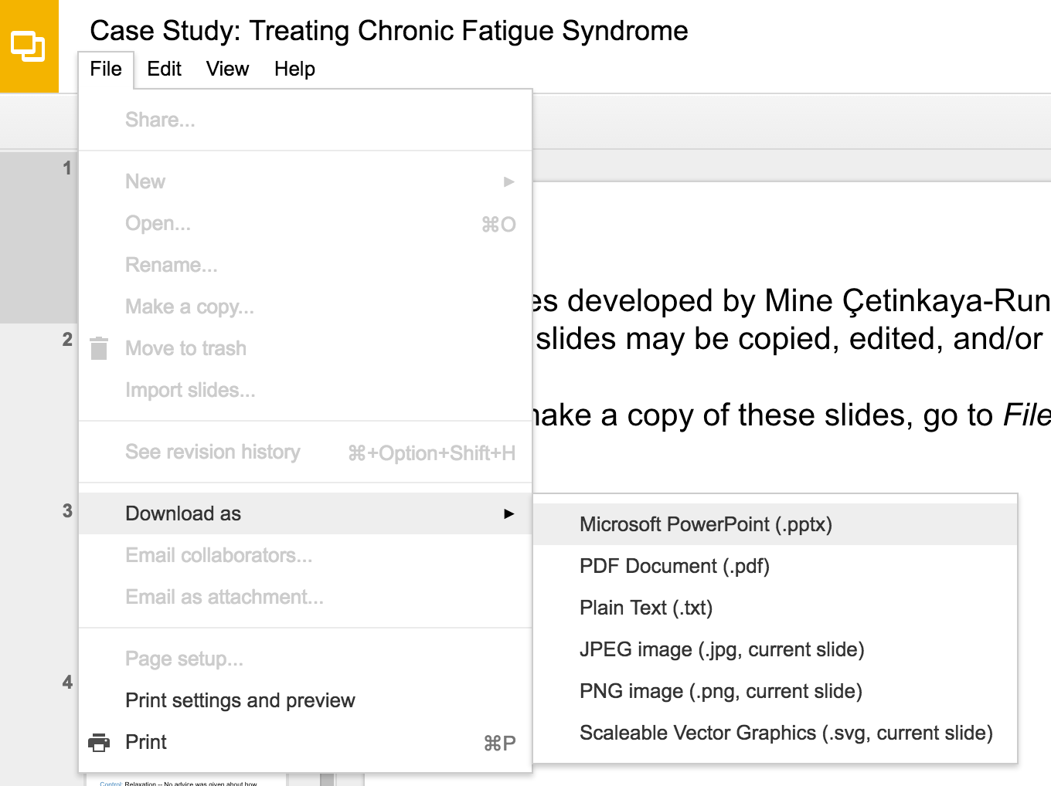
Slides developed by Mine Çetinkaya-Rundel of OpenIntro
Translated from LaTeX to Google Slides by Curry W. Hilton of OpenIntro.
The slides may be copied, edited, and/or shared via the CC BY-SA license
To make a copy of these slides, go to File > Download as > [option], as shown below. Or if you are logged into a Google account, you can choose Make a copy... to create your own version in Google Drive.

Slide 2
Point Estimates
and Sampling Variability

Slide 3
Parameter estimation
We are often interested in population parameters.
Since complete populations are difficult (or impossible) to collect data on, we use sample statistics as point estimates for the unknown population parameters of interest.
Sample statistics vary from sample to sample.
Quantifying how sample statistics vary provides a way to estimate the margin of error associated with our point estimate.
But before we get to quantifying the variability among samples, let's try to understand how and why point estimates vary from sample to sample.
Suppose we randomly sample 1,000 adults from each state in the US. Would you expect the sample means of their heights to be the same, somewhat different, or very different?

Slide 4
Suppose we randomly sample 1,000 adults from each state in the US. Would you expect the sample means of their heights to be the same, somewhat different, or very different?

Slide 5
Suppose we randomly sample 1,000 adults from each state in the US. Would you expect the sample means of their heights to be the same, somewhat different, or very different?
Not the same, but only somewhat different.

Slide 6
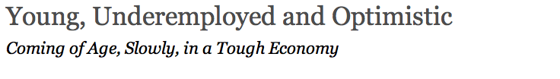
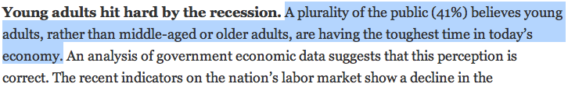
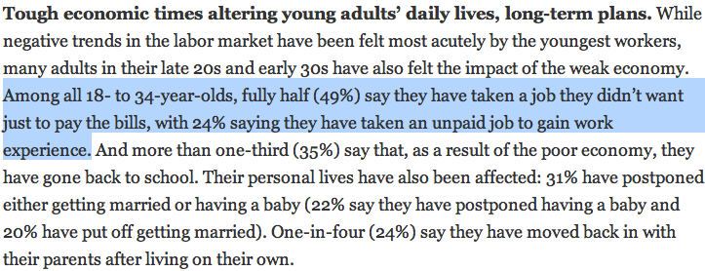
http://pewresearch.org/pubs/2191/young-adults-workers-labor-market-pay-careers-advancement-recession

Slide 7
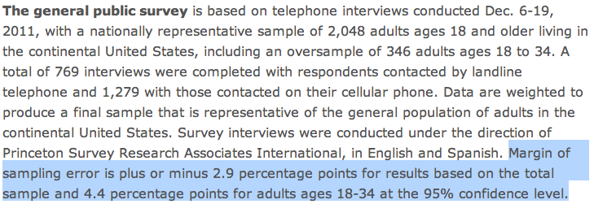
Margin of error
41% ± 2.9%: We are 95% confident that 38.1% to 43.9% of the public believe young adults, rather than middle-aged or older adults, are having the toughest time in today's economy.
49% ± 4.4%: We are 95% confident that 44.6% to 53.4% of 18-34 years olds have taken a job they didn't want just to pay the bills.

Slide 8
Suppose the proportion of American adults who support the expansion of solar energy is p = 0.88, which is our parameter of interest. Is a randomly selected American adult more or less likely to support the expansion of solar energy?

Slide 9
Suppose the proportion of American adults who support the expansion of solar energy is p = 0.88, which is our parameter of interest. Is a randomly selected American adult more or less likely to support the expansion of solar energy?
More likely.

Slide 10
Suppose that you don’t have access to the populaion of all Ameri- can adults, which is a quite likely scenario. In order to estimate the proportion of American adults who support solar power expansion, you might sample from the population and use your sample propor- tion as the best guess for the unknown population proportion.
Sample, with replacement, 1000 American adults from the population, and record whether they support solar power or not expansion.
Find the sample proportion.
Plot the distribution of the sample proportions obtained by members of the lass.

Slide 11
# 1. Create a set of 250 million entries, where 88% of
# them are "support" and 12% are "not".
pop_size <- 250000000
possible_entries <- c(rep("support", 0.88 * pop_size),
rep("not", 0.12 * pop_size))
# 2. Sample 1000 entries without replacement.
sampled_entries <- sample(possible_entries, size = 1000)
# 3. Compute p-hat: count the number that are "support",
# then divide by # the sample size.
sum(sampled sampled_entries == "support") / 1000

Slide 12
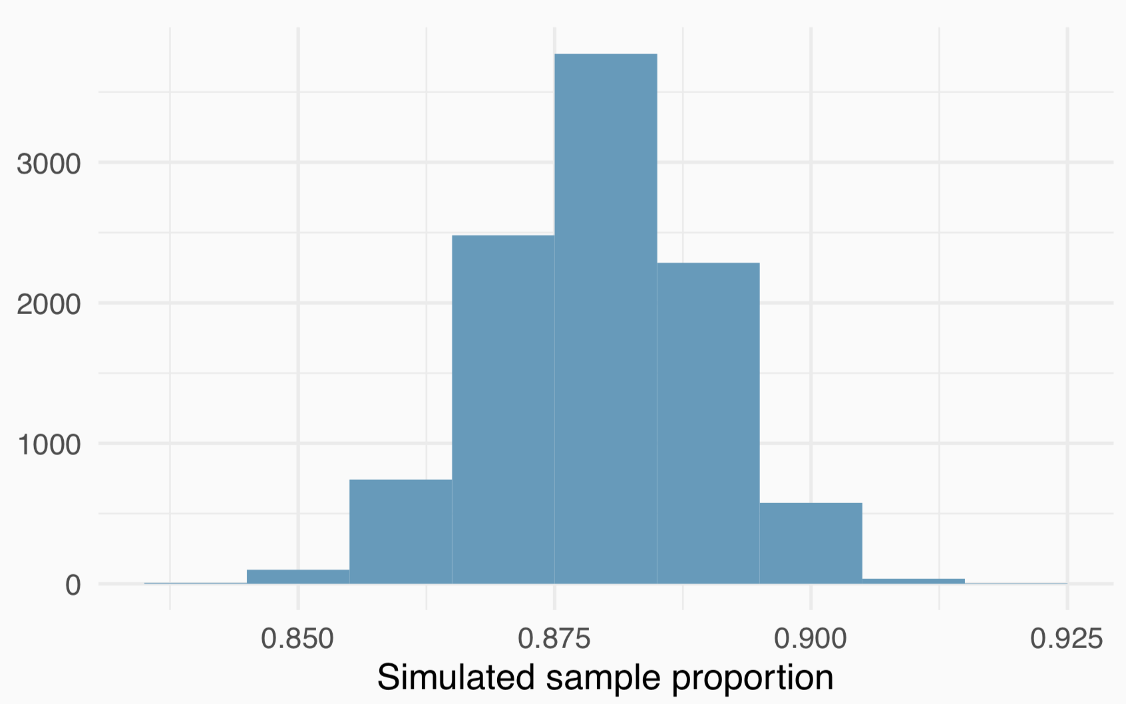
Sampling distribution
Suppose you were to repeat this process many times and plot the results. What you just constructed is called a sampling distribution.

Slide 13
Sampling distribution
What is the shape and center of this distribution?
The distribution looks symmetric and somewhat bell-shaped.

Slide 14
Sampling distribution
Based on this distribution, what do you think is the true population proportion?
The center of the distribution: about 0.88.

Slide 15
Sampling distributions are never observed
In real-world applications, we never actually observe the sampling distribution, yet it is useful to always think of a point estimate as coming from such a hypothetical distribution.
Understanding the sampling distribution will help us characterize and make sense of the point estimates that we do observe.

Slide 16
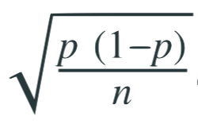
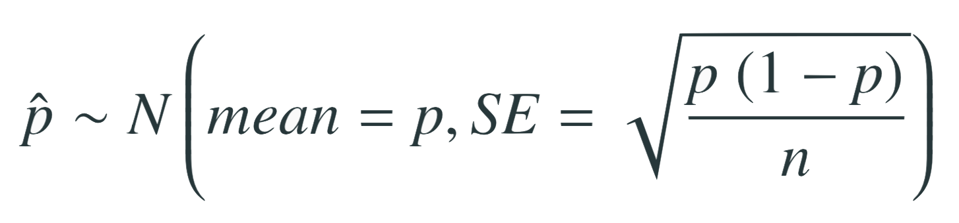
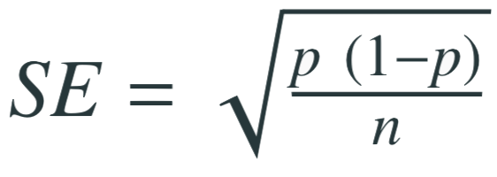
Central Limit Theorem
Sample proportions will be nearly normally distributed with mean equal to the population proportion, p, and standard error equal to
It wasn’t a coincidence that the sampling distribution we saw earlier was symmetric, and centered at the true population population.
We won’t go through a detailed proof of why
but note that as n increases SE decreases.
As n increases samples will yield more consistent p̂s, i.e. variability among p̂s will be lower.

Slide 17
CLT - conditions
Certain conditions must be met for the CLT to apply:
Independence
Sampled observations must be independent. This is difficult to verify, but is more likely if
random sampling/assignment is used, and
if sampling without replacement, n < 10% of the population.
Sample size
There should be at least 10 expected successes and 10 expected failures in the observed sample.
This is difficult to verify if you don’t know the population proportion (or can’t assume a value for it). In those cases we look for the number of observed successes and failures to be at least 10.

Slide 18
When p is unknown
The CLT states
with the condition that np and n(1 − p) are at least 10.
However, we often don’t know the value of p, the population proportion.
In these cases we substitute p̂ for p.

Slide 19
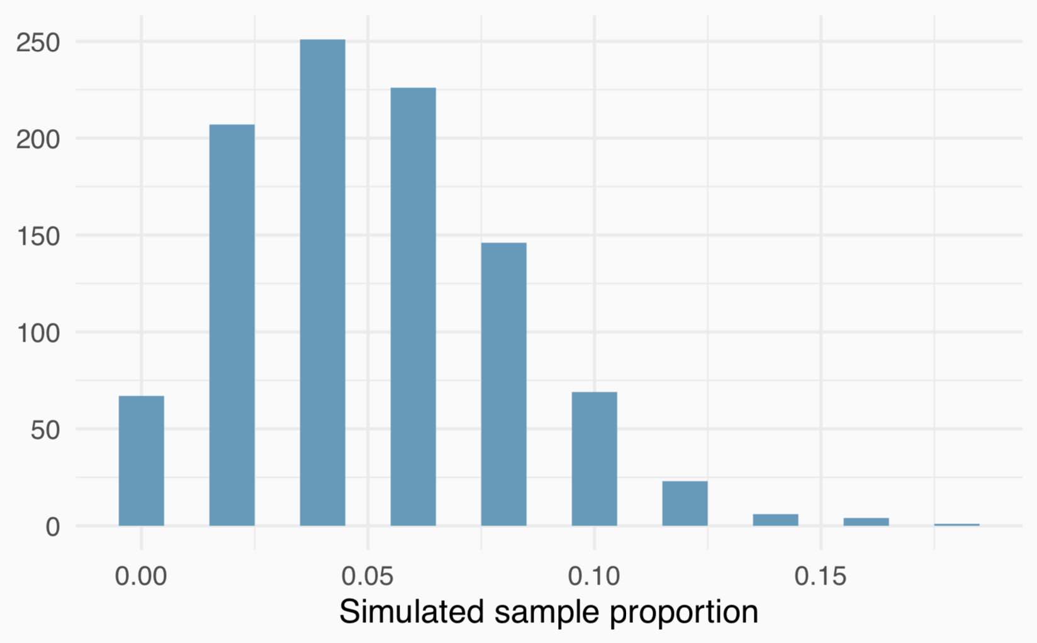
When np or n(1 - p) is small
Suppose we have a population where the true population proportion is p = 0.05, and we take random samples of size n = 50 from this population. We calculate the sample proportion in each sample and plot these proportions. Would you expect this distribution to be nearly normal? Why, or why not?
No, the success-failure condition is not met (50 x 0.05 = 2.5), so we would not expect the sampling distribution to be nearly normal.

Slide 20
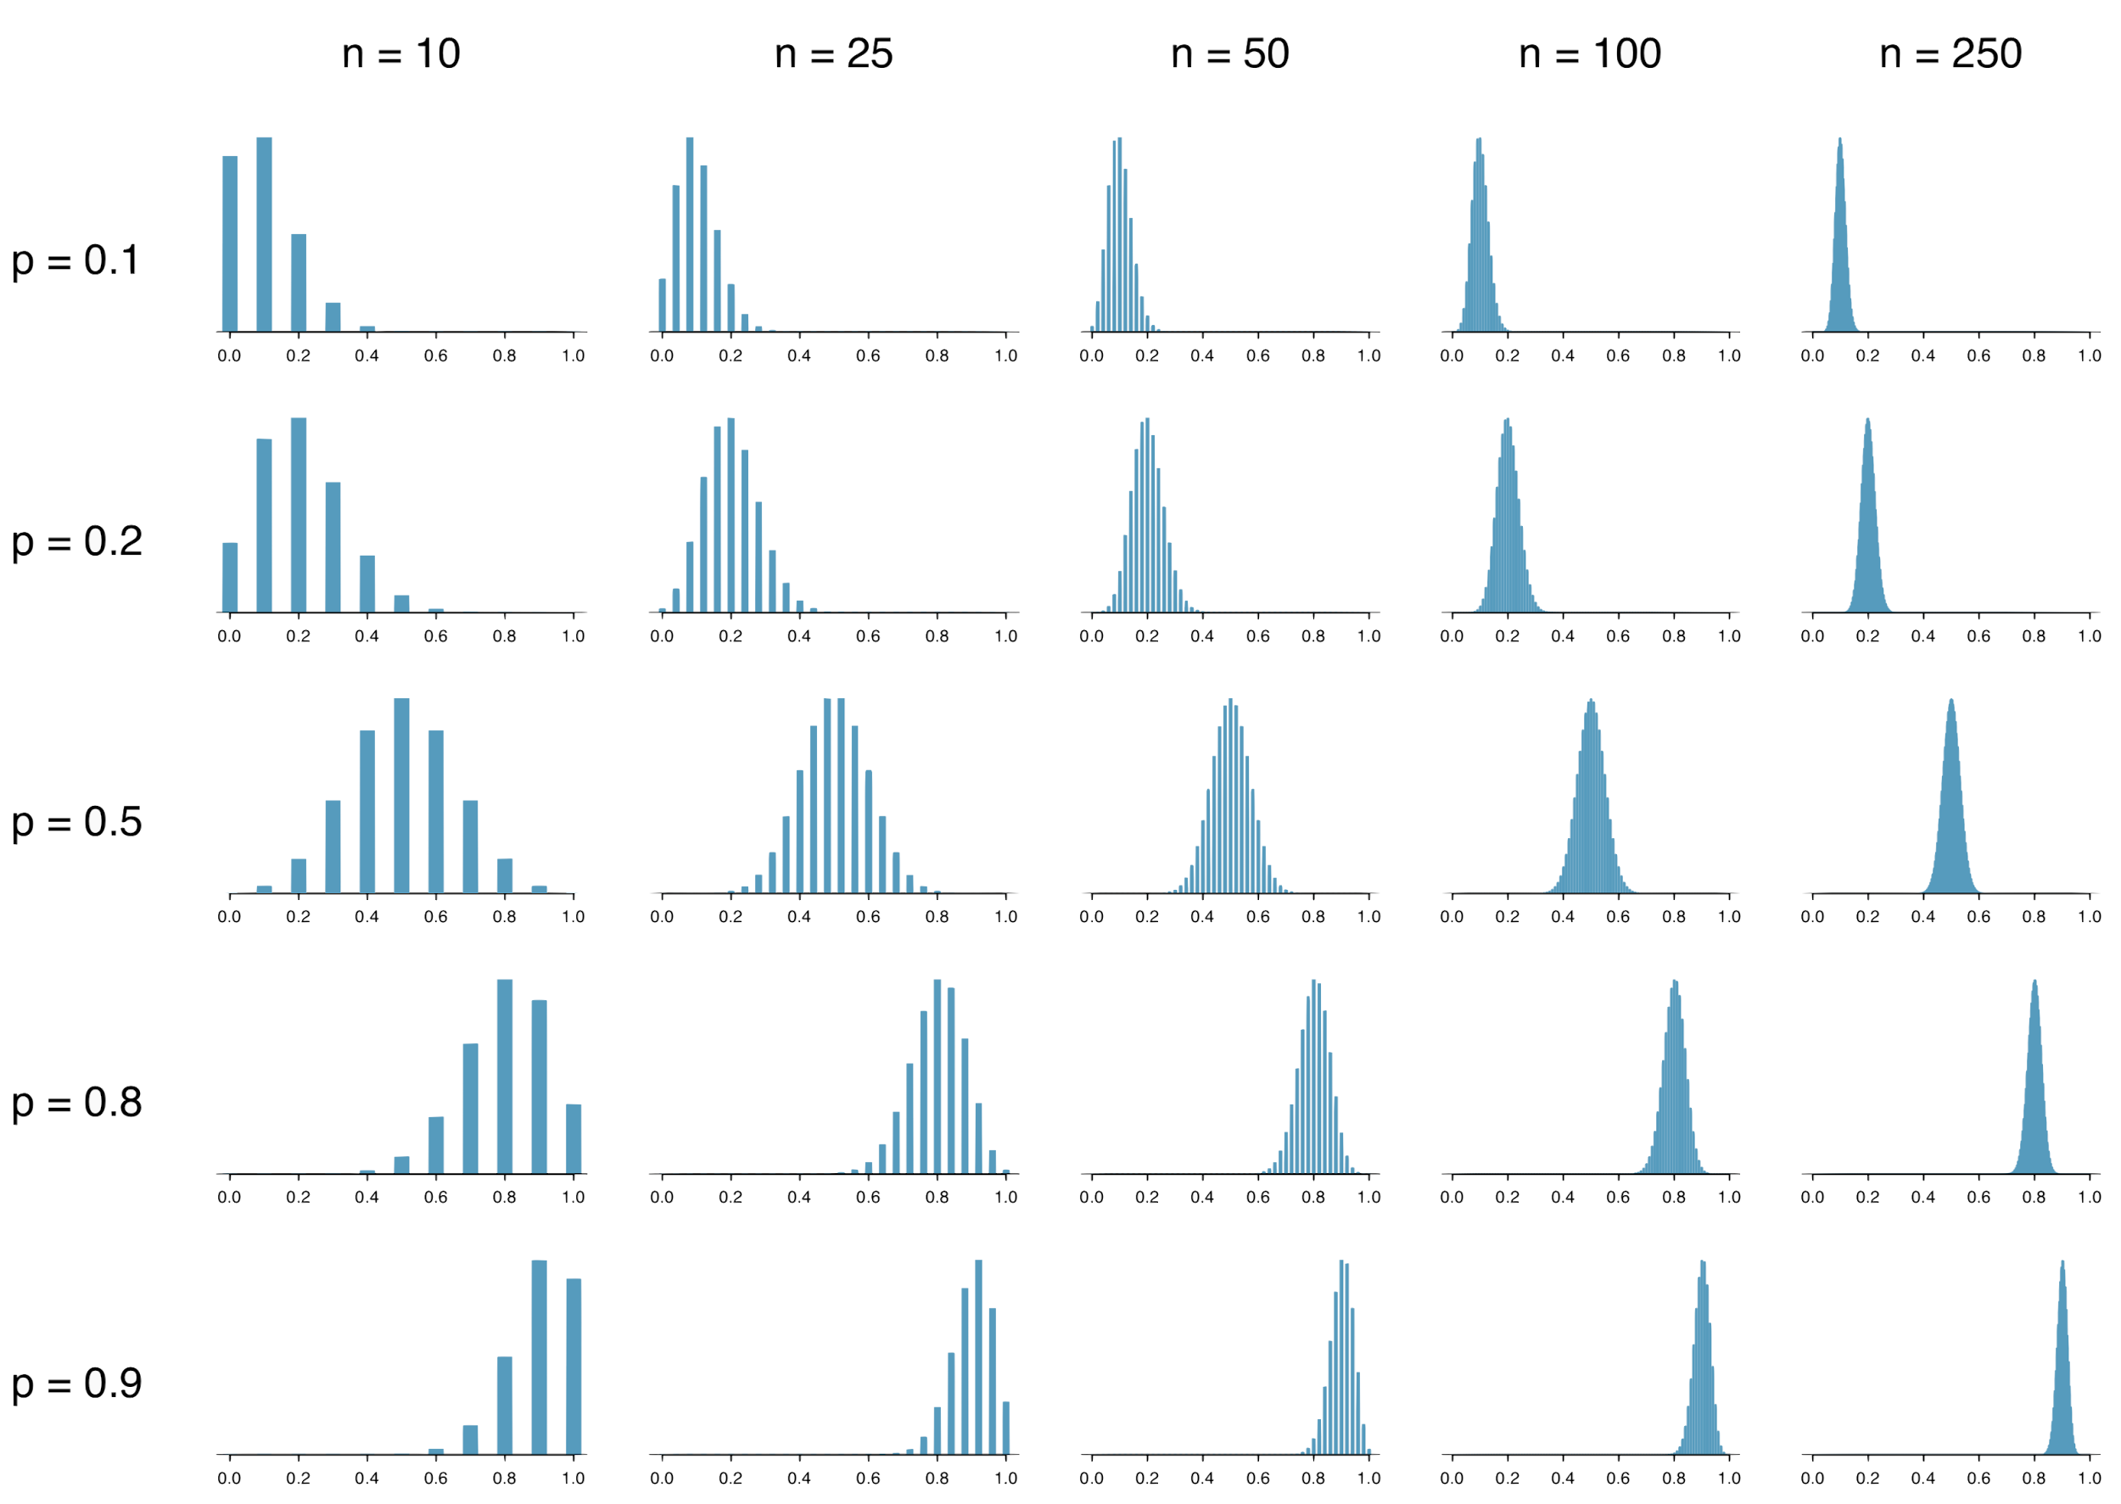
What happens when np and/or n(1 − p) < 10

Slide 21
When the conditions are not met...
When either np or n(1 − p) is small, the distribution is more discrete.
When np or n(1 − p) < 10, the distribution is more skewed.
The larger both np and n(1 − p), the more normal the
distribution.
When np and n(1 − p) are both very large, the discreteness of the distribution is hardly evident, and the distribution looks much more like a normal distribution.

Slide 22
Extending the framework for other statistics
The strategy of using a sample statistic to estimate a parameter is quite common, and it’s a strategy that we can apply to other statistics besides a proportion.
Take a random sample of students at a college and ask them how many extracurricular activities they are involved in to estimate the average number of extra curricular activities all students in this college are interested in.
The principles and general ideas are from this chapter apply to other parameters as well, even if the details change a little.

Slide 23
Find more resources at openintro.org/os, including
Slides
Videos
Statistical Software Labs
Discussion Forums (free support for students and teachers)
Learning Objectives
Teachers only content is also available for Verified Teachers, including
Exercise solutions
Sample exams
Ability to request a free desk copy for a course
Statistics Teachers email group
Questions? Contact us.

Slide 24
Extra Slides from the OS3 section on point estimates

Slide 25
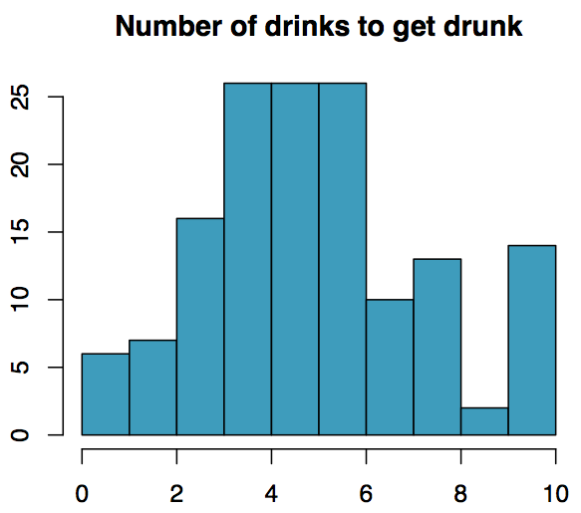
Practice
The following histogram shows the distribution of number of drinks it takes a group of college students to get drunk. We will assume that this is our population of interest. If we randomly select observations from this data set, which values are most likely to be selected, which are least likely?

Slide 26
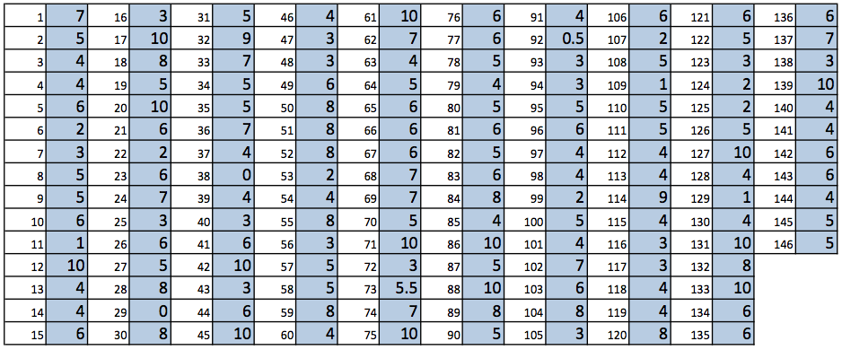
Suppose that you don't have access to the population data. In order to estimate the average number of drinks it takes these college students to get drunk, you might sample from the population and use your sample mean as the best guess for the unknown population mean.
Sample, with replacement, ten students from the population, and record the number of drinks it takes them to get drunk.
Find the sample mean.
Plot the distribution of the sample averages obtained by members of the class.

Slide 27
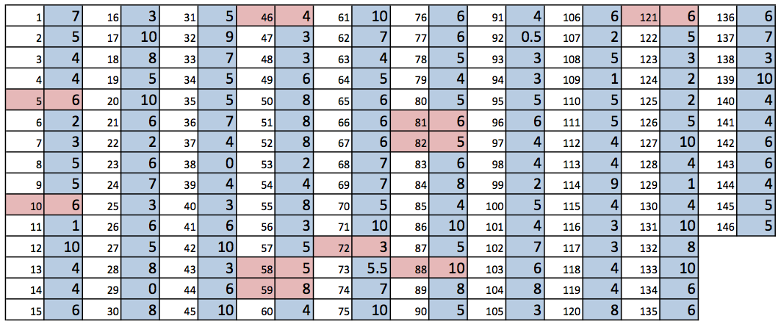
Example
List of random numbers: 59, 121, 88, 46, 58, 72, 82, 81, 5, 10

Slide 28
Example
List of random numbers: 59, 121, 88, 46, 58, 72, 82, 81, 5, 10
Sample mean: (8+6+10+4+5+3+5+6+6+6) / 10 = 5.9

Slide 29
Sampling distribution
What you just constructed is called a sampling distribution.

Slide 30
Sampling distribution
What you just constructed is called a sampling distribution.
What is the shape and center of this distribution? Based on this distribution, what do you think is the true population average?

Slide 31
Sampling distribution
What you just constructed is called a sampling distribution.
What is the shape and center of this distribution? Based on this distribution, what do you think is the true population average?
Approximately 5.39, the true population mean.

Slide 32
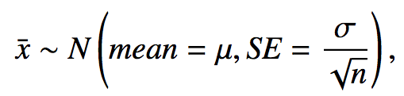
Central Limit Theorem
The distribution of the sample mean is well approximated by a normal model:
where SE is represents standard error, which is defined as the standard deviation of the sampling distribution. If σ is unknown, use s.
It wasn't a coincidence that the sampling distribution we saw earlier was symmetric, and centered at the true population mean.
We won't go through a detailed proof of why SE = σ / √n, but note that as n increases SE decreases.
As the sample size increases we would expect samples to yield more consistent sample means, hence the variability among the sample means would be lower.

Slide 33
CLT - conditions
Certain conditions must be met for the CLT to apply:
Independence: Sampled observations must be independent. This is difficult to verify, but is more likely if
random sampling / assignment is used, and
if sampling without replacement, n < 10% of the population.

Slide 34
CLT - conditions
Certain conditions must be met for the CLT to apply:
Independence: Sampled observations must be independent. This is difficult to verify, but is more likely if
random sampling / assignment is used, and
if sampling without replacement, n < 10% of the population.
Sample size / skew: Either the population distribution is normal, or if the population distribution is skewed, the sample size is large.
the more skewed the population distribution, the larger sample size we need for the CLT to apply
for moderately skewed distributions n > 30 is a widely used rule of thumb
This is also difficult to verify for the population, but we can check it using the sample data, and assume that the sample mirrors the population.

